Slide 1

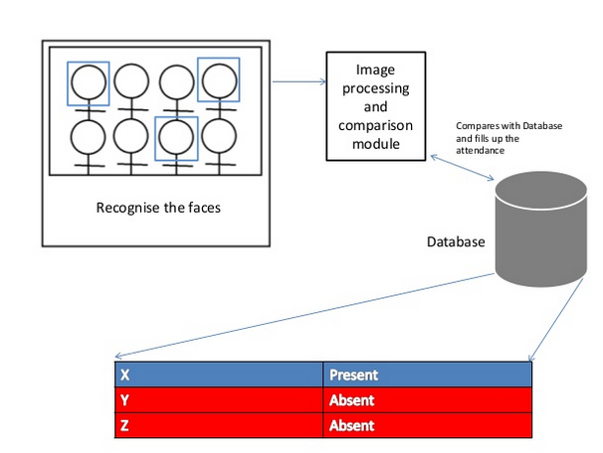
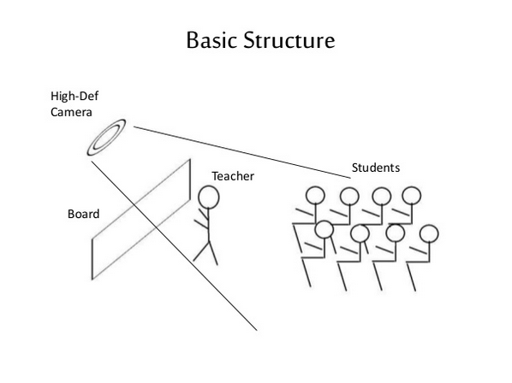
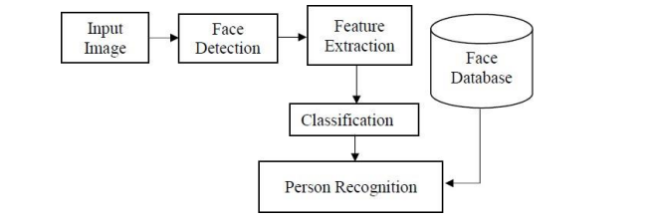
Proposed Architecture/ Diagram:
MIT SCHOOL OF COMPUTING
Class : DA
Group Id:11
DEPARTMENT OF COMPUTER SCIENCE & ENGINEERING
Face Recognition Attendance System
Omkar Rasal , Rajdeep Asane , Prathmesh Pawar , Harshal Chaudhari
Faculty Guide:
Prof.Rajkumar Patil
Abstract/ Objectives:
Empathy Chart
Ideation
Proposed Block diagram
P
1. It can be accessed by unlimited number of users.
2.The user can have access to all the information in the site with limited services and provide extra services to registered users.
3.Only registered members will be provided with communication between user, experts and owner of the house.
4. . Our project laid a web based platform for the city guide and can search every place in the city with out taking the help of any personal broker.
Problem Statement:-Face recognition-based attendance system is a problem of recognizing face for taking attendance by using face recognition technology based on high definition monitor video and other information technology. facial image for easier recognition
Proposed Solution:-Face detection is a computer technology used to identify human faces in digital images by determining the location of the faces in the image and extract sub images for each face.
Scope and Feasibility:- Once the software is developed and tested properly, it could be improved to cover full institutions such as the faculty of engineering.

